Slide 1
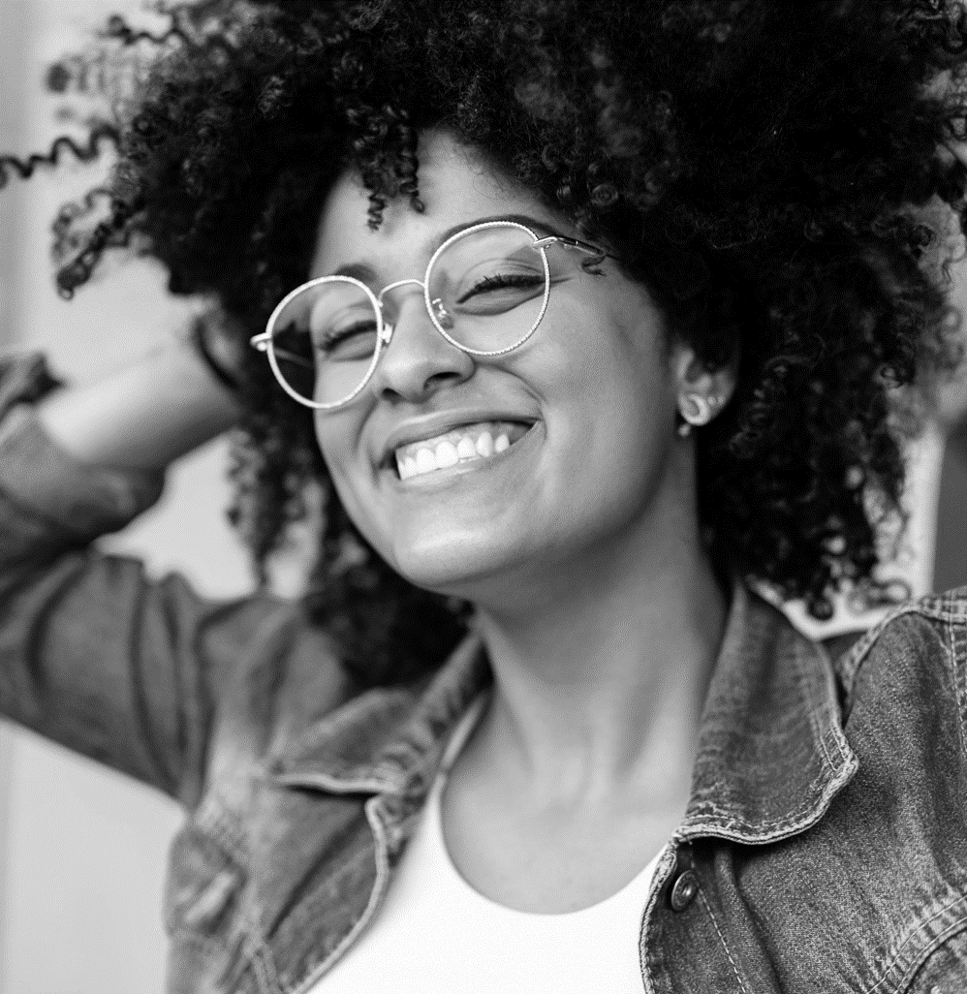
Big Brothers Big Sisters of Sarnia-Lambton
United Way Funding
Matching Program - $80,000
Go Girls Game On Program - $30,000
Big Bunch Program - $20,000
In School Mentoring - $18,000 (as of April 1, 2024)

Slide 2
Children helped by Big Brothers Big Sisters in 2023-24
Matching – 125 youth
Go Girls Game On – 340 youth
Big Bunch – 44 youth

Slide 3
Program Descriptions
The Matching program provides friendship and consistent stabilizing support to children and youth in our community through being matched with a positive adult influence. Often at the point of referral the children in the program have seen people come and go in their lives through various circumstances including family breakdown.
Go Girls Game On serves adolescent girls and boys through a group mentoring program based around physical activity, healthy eating, self-esteem, and communication. Sessions take place weekly in schools during school hours.
Big Bunch was created specifically in demand to an identified gap in service as there are many children on the waiting list for a Big Brother or Sister match. In Big Bunch 3 Littles are matched to 1 mentor and meet bi-weekly as a group.
In School Mentoring provides one-to-one support to children ages 4-15, for one hour a week at the child’s school during school hours. This is fun based rather than academic based with the goal of improving the child’s self-esteem and helping to make school a more positive experience.

Slide 4
Program Results
Matching Program
100% of parents surveyed felt that since being matched there has been an improvement in their child’s mental health
100% of Littles surveyed feel that their Mentor is a safe and supportive person in their life
86% of Littles surveyed have tried something with their Mentors that they otherwise would not have been able to
Go Girls Game On Program
92% of participants indicated they have made healthier food choices based on what they have learned
82% of participants now choose to do physical activity on their own
90% of participants feel they have developed better or new relationships with others in the group and now have relationships with their peers in their school classes that they did not before
Big Bunch
90% of Little’s react more positively to challenges
95% of Little’s interact more with peers without being prompted
89% of Little’s gained more confidence to try new things

Slide 5
Testimonials
Parent of a Little Sister:
“Since my child has been in the program her mental health has completely improved, every issue she had coming into the program has been addressed and resolved, having her Big Sister in her life has changed our lives.”
Little Brother:
“I met my Big Brother when I was 8. It was just me my mom and my two sisters. I liked that it was just him and I when together and he listened. He asked questions and then really listened to my answers. Fast forward 10 years and our match is now officially done. My Big Brother and I have spent time together every week for 10 years. When I was having the worst days or the best days, I knew he was a text away. He has helped me through some pretty dark days and helped to guide me into this next part of my lift. Not sure what things would have been like if I did not meet him."
Elementary Teacher re Go Girls Game On program:
“This program has been one we welcome every year into our school. A lot of our students struggle with healthy relationships, self image and boundaries. I feel the students have a sense of calm when they come back from the program each week. They are learning tools and bringing them back to the classroom.”

