Slide 1


Family Counselling Centre
United Way Funding
Subsidized Counselling - $87,000
Distress Line / Tel Check - $13,000
Suicide Prevention - $20,000 (ended March 31, 2024)

Slide 2
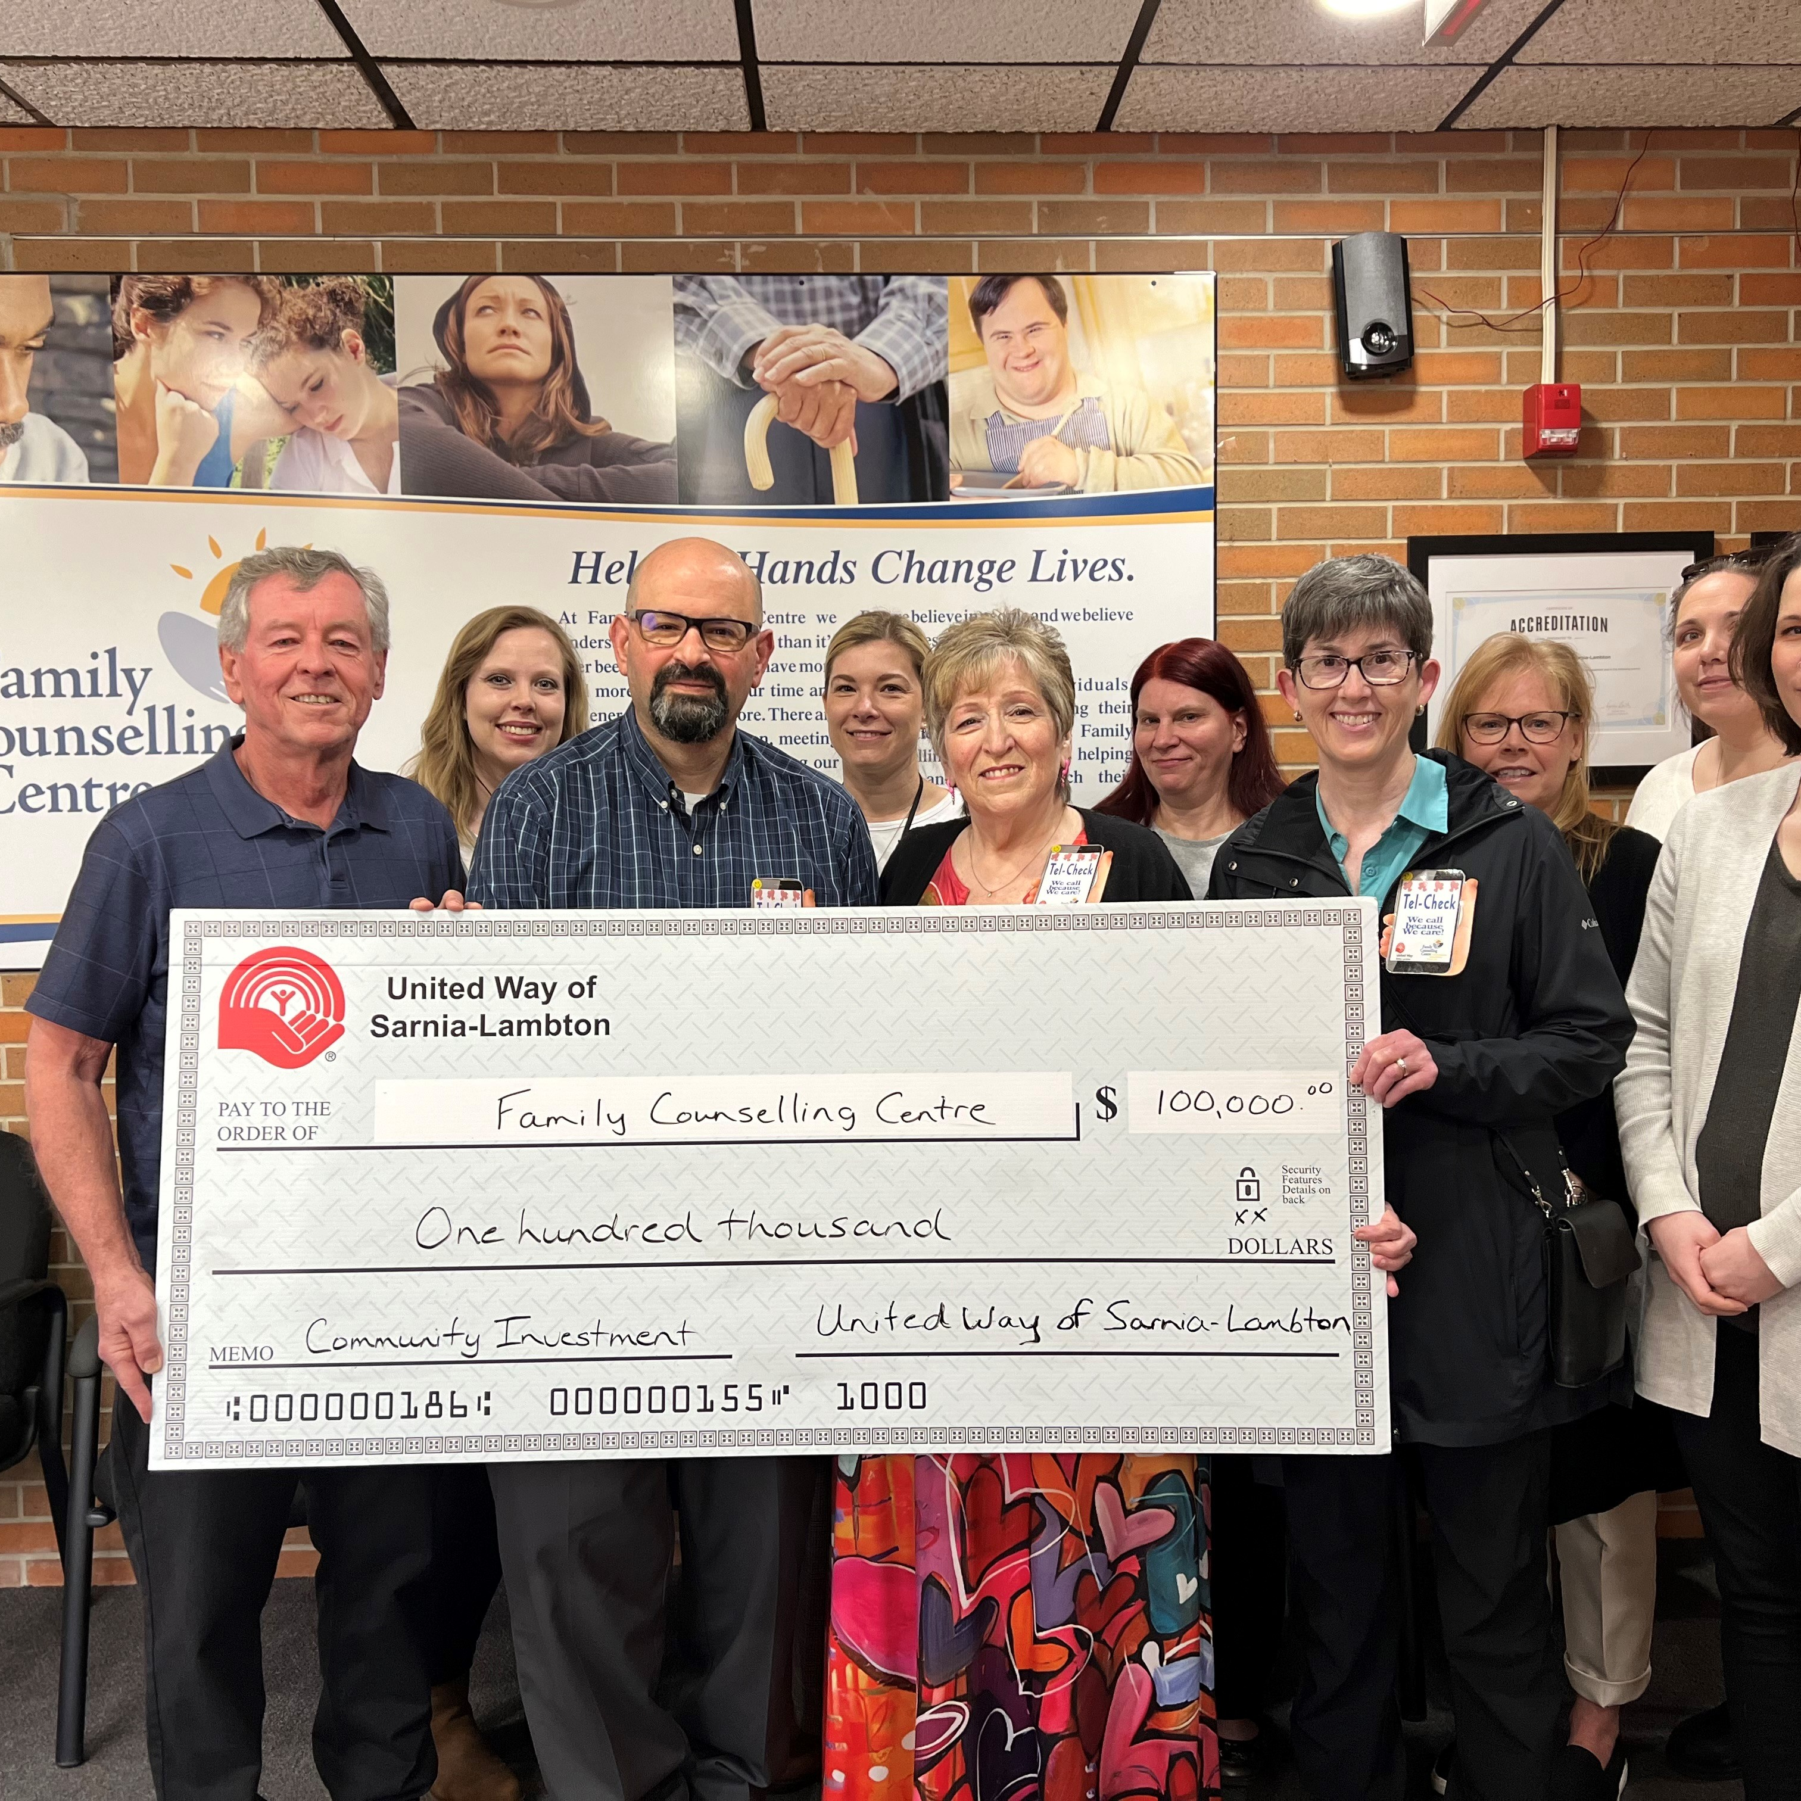

Individuals helped in 2023-24
Counselling – 427 individuals
Tel-Check calls made – 65,436
Suicide Prevention – 512 individuals

Slide 3

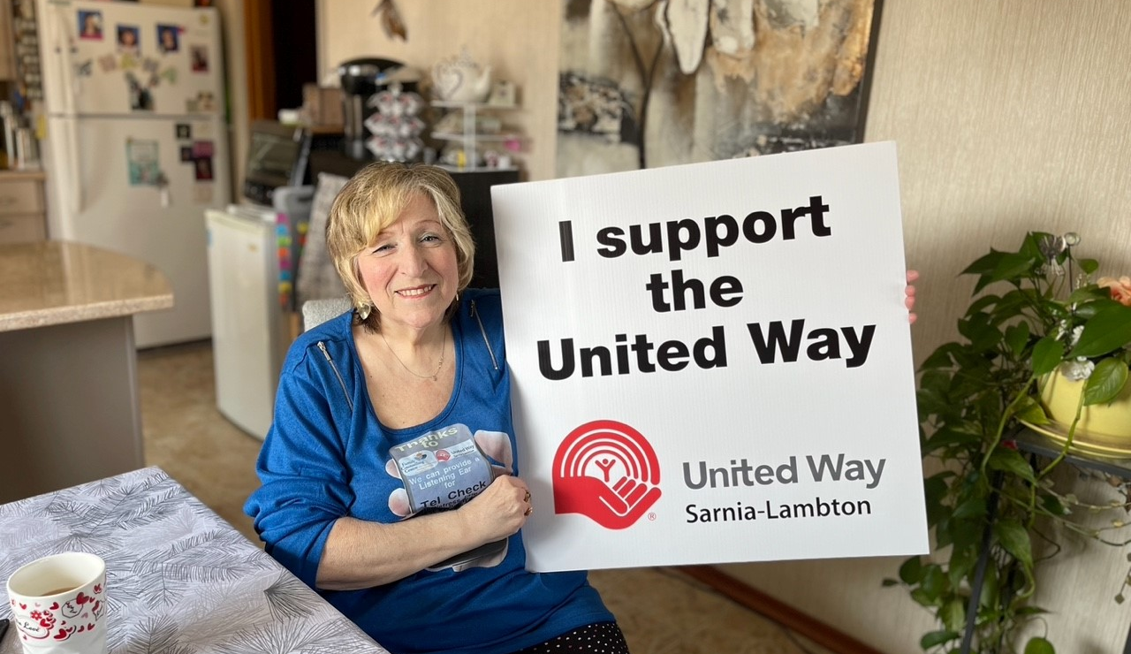
Program Descriptions
Subsidized counselling provides low-income residents of Lambton County with access to timely, affordable, and professional counselling services, geared to (verified) family income rate. Counselling sessions are held confidentially and privately.
Distress Line / Tel-Check is a generic telephone support service where individuals from across Sarnia Lambton can call from 7:00 a.m. to midnight 7 days a week to talk about worries, fears, depression, anxiety, grief and loss, domestic violence, suicide, mental illness, family breakdown, housing & finances, etc. During the year, many callers shifted to the 9-8-8 National suicide helpline. Tel-Check are outgoing calls made to seniors, individuals with disabilities, adults and youth to help reduce the clients’ sense of isolation; for wellness & safety check-ins; to give reminders for medication, nutrition/hydration; and make referrals to health and social supports.
Suicide Prevention works to promote suicide awareness within Sarnia Lambton.

Slide 4

Program Results
Results
83% of counselling clients for whom anxiety, depression, and/or feeling of isolation were an issue indicated a positive difference after completion of counselling sessions
100% of Distress Line callers who presented as ‘at risk’ of suicide at the time of calling were provided with support, safety planning and/or intervention with emergency services
71% of callers reported that because of this support there was a perception of a decrease in isolation, decrease in distress/anxiety, an increased ability to cope, the ability to explore options, and the caller feeling better; the immediate crisis was diffused

Slide 5

Testimonials
Clients:
“Great tools to help me in my relationship and personal life.”
“Cathy saved my life, I’m grateful for having her in my life now.”
“My family and I have been affected with the loss of a loved one by suicide. I was encouraged by my counselor to attend a Suicide Loss Group session. This group has been very helpful, encouraging, understanding and most of all supporting through every step of my grief journey. I continue to attend monthly meetings and stay connected to some of my group support members. I am thankful.”

