Slide 1
Habitat for Humanity
United Way Funding
Handyman Program (subsidized handyman rates) - $15,000
This Photo by Unknown Author is licensed under CC BY

Slide 2
Families helped by the Handyman Program in 2023-24
531 Families Served

Slide 3
Program Description
Habitat for Humanity Sarnia-Lambton offers the Handyman program to help Sarnia-Lambton residents maintain their home with home repairs and renovations that will allow them to remain living safely and independently in their own home. Volunteers work alongside the Habitat Handyman Supervisors to complete home repairs including:
flooring installation
drywall installation and or repair
fence and deck construction or repair
interior and exterior painting
yard maintenance and clean up
kitchen and bathroom repairs and renovations
vinyl siding repair, removal or installation
To be considered for subsidized pricing (where United Way dollars are used), clients must provide proof of income which must fall within the High Needs Household Income Limits (HILS).

Slide 4
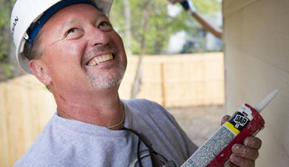
Program Results
Handyman Program
25% increase in small jobs completed (those under $400)
76% increase in families served over last year
531 families served

