Slide 1
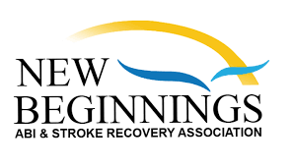
New Beginnings, ABI & Stroke Recovery Association
United Way Funding
Community Integration - $20,000

Slide 2
Individuals helped in 2023-24
Community Integration – 102 individuals

Slide 3
Program Descriptions
New Beginnings provides support to survivors and to their families and caregivers through adult day programming and caregiver support.
Programs offered assist members by introducing them to programs that stimulate the brain to increase memory power and vision control, as well as giving members the tools necessary for them to make sound decisions. They also offer fitness classes specifically geared towards survivors which helps increase their physical strength and, in some cases, can assist them with mobility so they no longer require assistive devices.
Hot, nutritious lunches and basic fruit options are provided at the Centre for a small fee. For some, this is the only hot meal they receive each day.

Slide 4
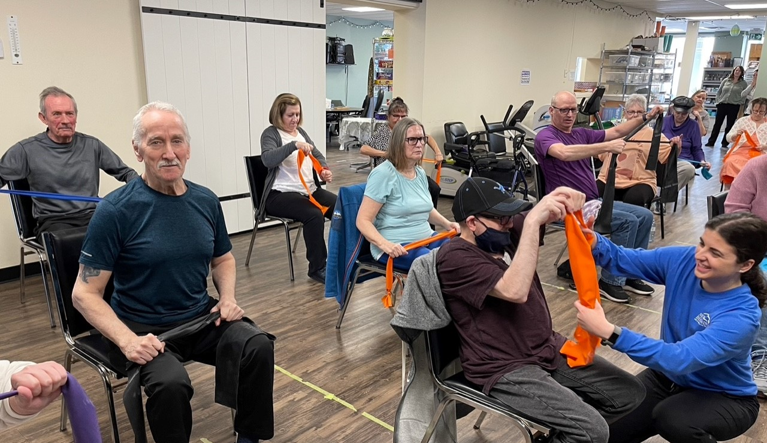
Program Results
Community Integration
100% of members have access to a cellphone, computer or tablet. Members are taught how to use social media chat features to decrease isolation, access coupon apps that help make shopping more affordable and use brain training apps designed to supercharge cognitive skills
27% of members have shown improvement in their baseline Seniors Fitness Test

Slide 5
Testimonials
Stroke Survivor:
“I have been a member for 2 years and I am now able to feel muscle in my arms and legs since I have committed to exercising in the program 3-4 days per week. I am also able to stand for longer periods of time and my balance has improved. I no longer struggle to get up from a chair and feel much better overall. I have also lost 100 pounds and been able to keep it off.”
This Photo by Unknown Author is licensed under CC BY-ND

