Slide 1
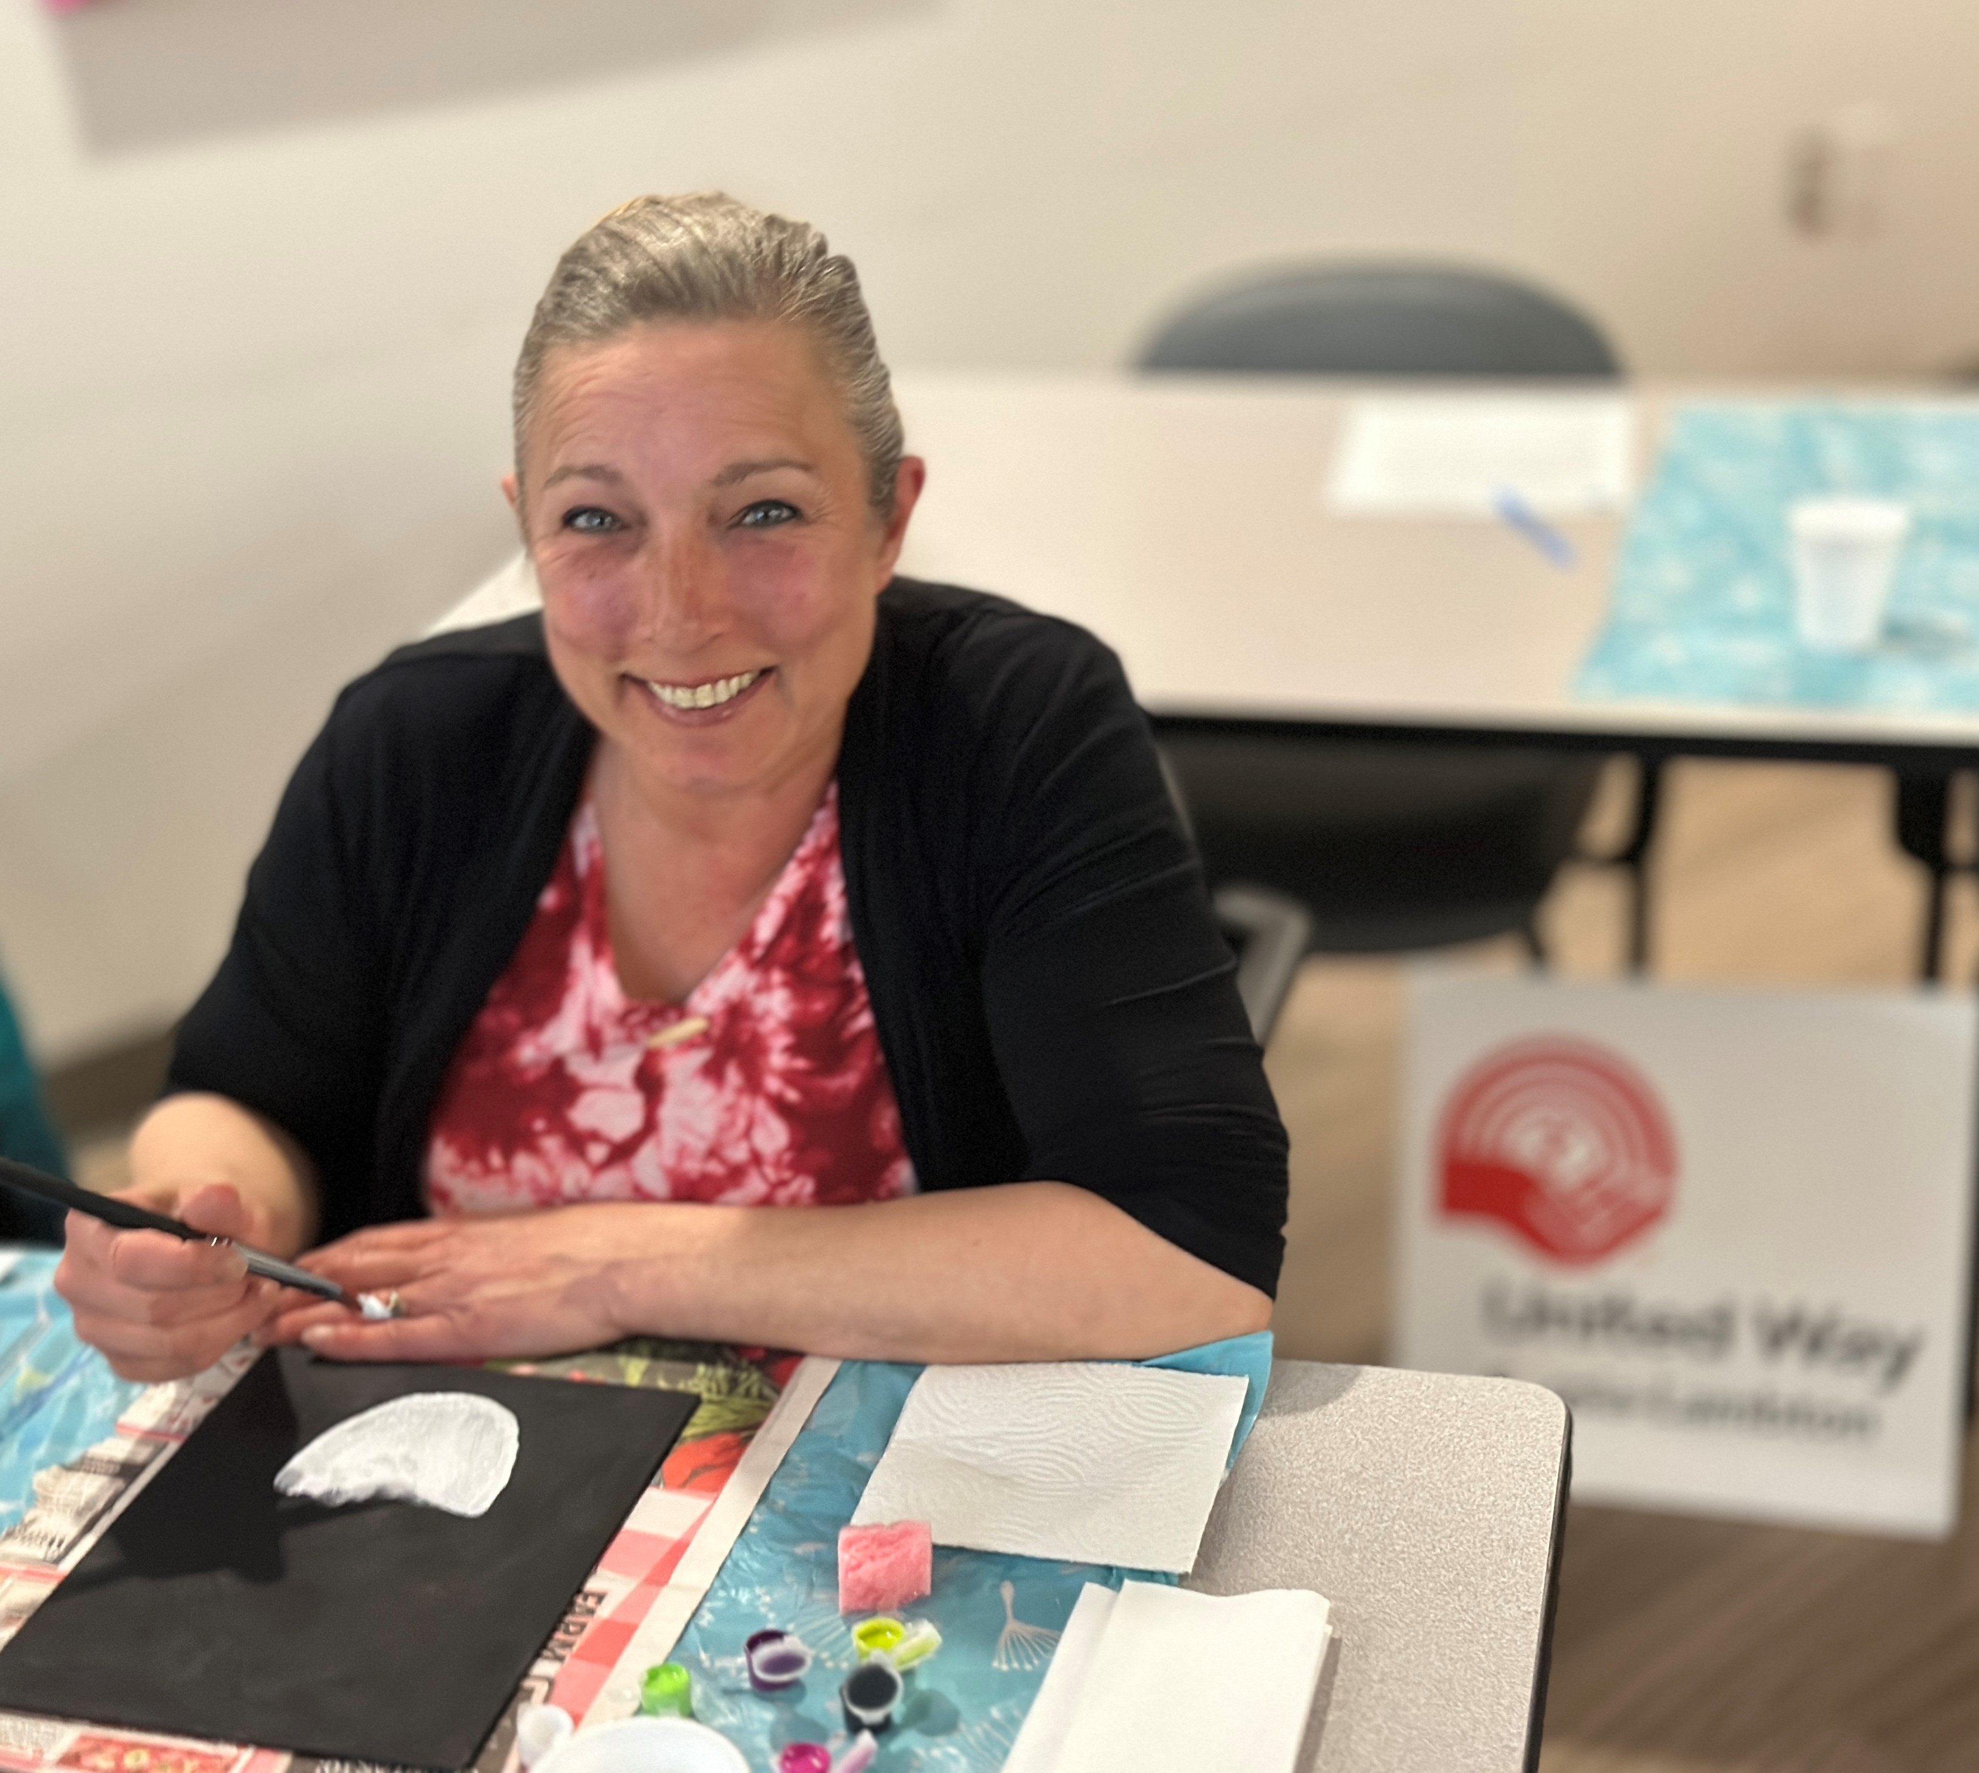
North Lambton Community Health Centre
United Way Funding
Opening Doors - $60,000

Slide 2
Individuals helped in 2023-24
4475 Individuals helped

Slide 3
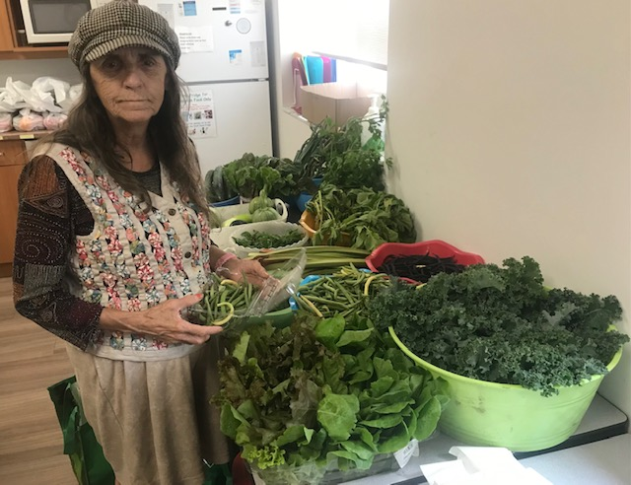
Program Descriptions
The Opening Doors program aims to create an environment of respect and community leadership by providing supportive mental health programming to people 16 years and older. Guidance and support is provided to make the changes the clients want to make.
Physical activity sessions, food access coupled with balanced and nutritious cooking classes, as well as planting, maintenance and harvesting of the Opening Doors gardens in Forest and Sarnia are all provided.
Clients accessing the program are also immediately connected to all pertinent service providers within the Community Health Centre including Chronic Disease Support, Social Worker, Occupational Therapist, Transportation, Dietitian, Housing Supports and Community Navigator.

Slide 4
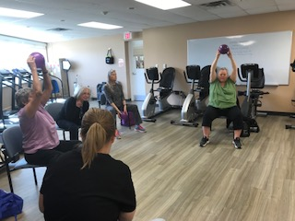
Program Results
Opening Doors
87% of participants have an improved state of mental health and reduced isolation
85% of participants improved their healthy living skills, knowledge of food and nutritious eating and increased their physical activity

Slide 5
Testimonials
Opening Doors Clients:
“Thank you for believing in me and seeing the person I have been fighting to get back to. I’ve been enjoying my time with everyone, and it makes me feel not so alone”
“ My husband passed away 12 years ago and up until Covid I was active in the workforce. Then things cam to a screeching halt. I now came face to face with things I allowed my professional life to hide. Coming from a generation that did not accept mental illness for what it is – an illness – the signs are hard to understand.”

