Slide 1
River City Vineyard
United Way Funding
Shelter Security Guard - $71,938
Note: this was previously funded by Community Services Recovery Fund

Slide 2
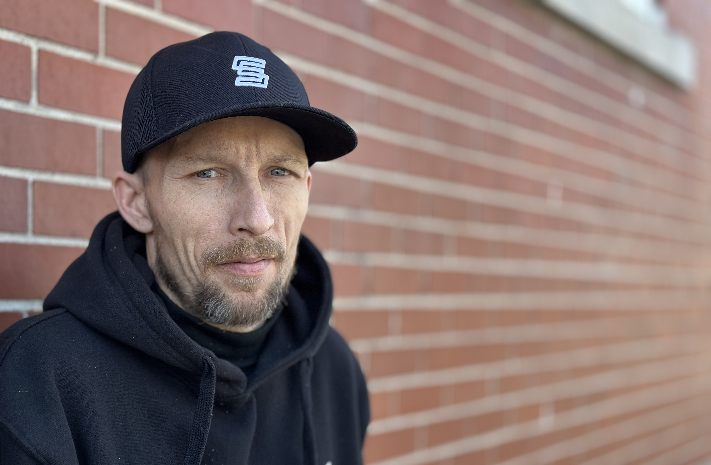
Individuals helped in 2023-24
Shelter Expansion – can house up to 40 “hard to house” individuals each night. Last year over 130 unique individuals were helped through this program.

Slide 3
Program Descriptions
River City Vineyard currently runs a homeless shelter that houses 68 beds, 53 for men and 15 for women. Of these 68 beds, 40 are for those who are “harder to house” who have no where else to go. These individuals often suffer from mental health and addiction issues and have often burned every other possible bridge due to risky and destructive behaviors and therefore usually live on the street. With this comes an increased safety and security risk to the staff and other guests. The security guard who is trained in and has experience dealing with unique shelter environments greatly increases the safety and security of all at River City Vineyard while allowing the “harder to house” individuals to have a bed to sleep in from 9pm until 9am. This security staff is also trained to de-escalate a situation before it can be a major problem and needing the intervention of police.

Slide 4
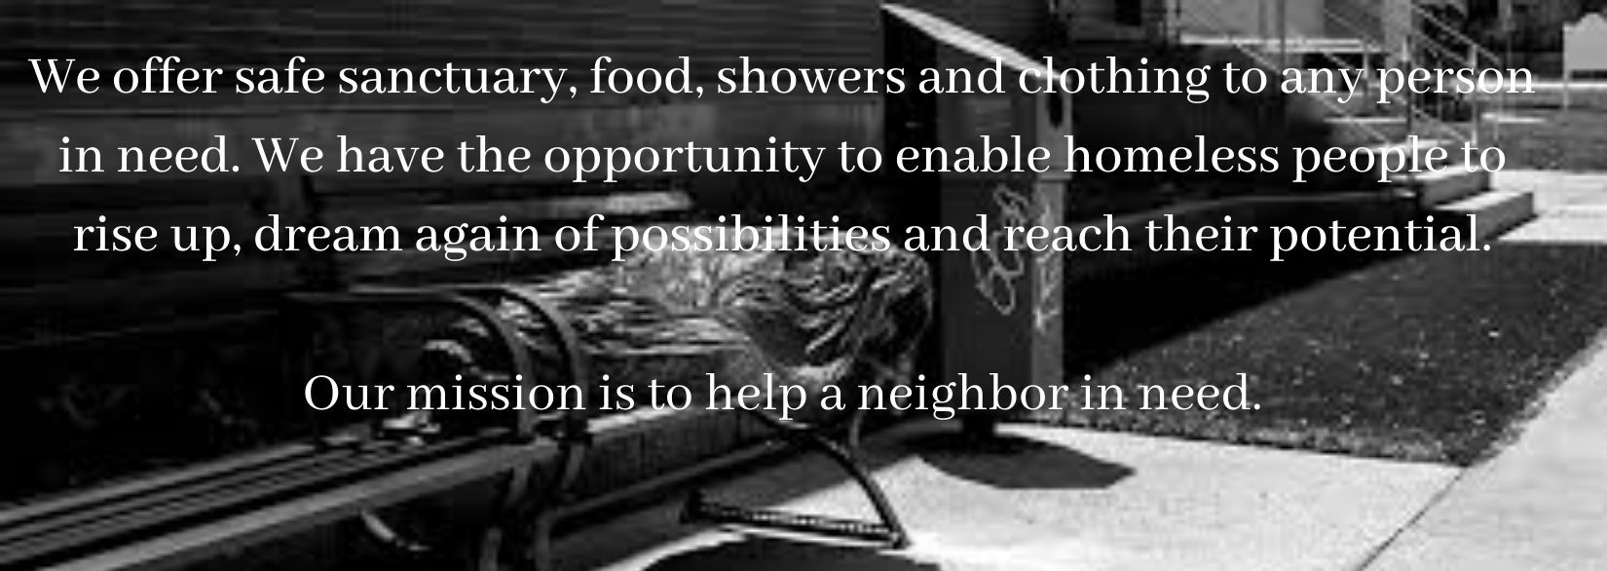
Program Objectives
Shelter Security Guard
85% of altercations per month can be successfully de-escalated without requiring police intervention
5 – 10 individuals per year no longer need the shelter at River City because they have secured more permanent housing

Slide 5
United Way dollars at work
“We strongly feel that every human being, regardless of circumstance, should have a safe place to sleep at night. One of the biggest issues in housing some of the homeless population is understanding that not every individual fits the same mold. Some will never be able to be properly housed even if a space becomes available. Housing every homeless individual sounds good in discussion, but simply isn’t possible if their mental health is too far deteriorated or if their addiction is out of control, Ignoring the issue doesn’t make it go away. If they have no where else to go , they sleep in places they shouldn’t and are still out in the streets causing issues overnight. They are sleeping in the freezing cold. We want to at least see these broken individuals have somewhere to sleep for the evening that is safe for them.” - Shelter Volunteer

