Slide 1
Salvation Army
United Way Funding
Rent & Utility Assistance - $40,000
Dental Assistance - $10,000
Medical Assistance - $10,000
Hearing Aid Assistance - $10,000

Slide 2
Individuals helped in 2023-24
Rent & Utility Assistance – 59 individuals
Dental Assistance – 30 individuals
Medical Assistance – 81 individuals
Hearing Aid Assistance – 8 individuals
This Photo by Unknown Author is licensed under CC BY-NC-ND

Slide 3
Program Descriptions
Rent & Utility assistance – Client provides personal information such as persons in the household, source of income, etc. Once provided a meeting is set up to speak more about the specifics of their situation to understand how they fell behind and how they can be more successful in future. A client is allowed to access this program once every 3 years for either rent or utility assistance, not both.
Dental Assistance – Client provides personal information, and the dental/denturist office provides details of the work to be completed along with the cost. This program can be accessed once in a lifetime.
Medical Assistance – Clients are permitted to request assistance up to $200 per person per year after going through a screening process to determine eligibility.
Hearing Aid Assistance – One time assistance for those who need hearing aids and successfully complete the screening process.

Slide 4
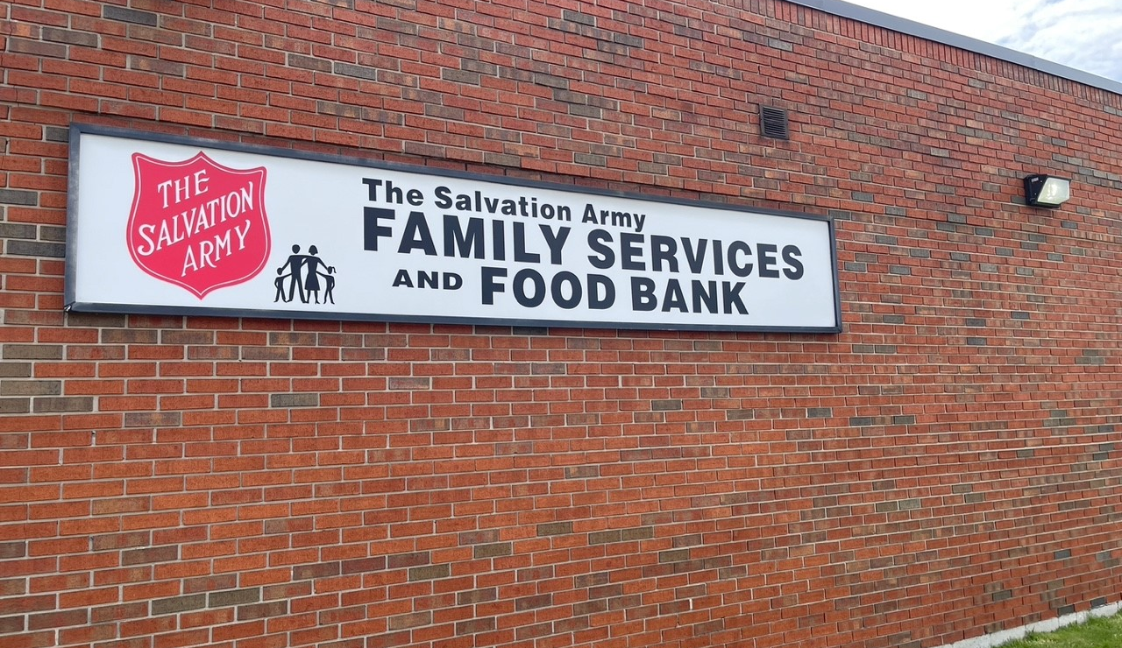
Program Results
Rent & Utility, Dental, Medical & Hearing Aid Assistance programs
20 households assisted were able to either maintain their residency or secure long-term housing
67% of clients receiving Dental assistance required dentures to improve their dietary health
87% of seniors assisted with hearing aids reported a better quality of life

Slide 5
United Way dollars at work
We assisted a mother and child to secure long term housing when leaving a domestic violence situation. Due to the urgency and seriousness of the situation the client did not have the funding for both the first and the last month’s rent but needed to leave her current residency for the safety of herself and her child. This client was able to find a new home where she feels safe and was allowed to move in with only the first month’s rent but was at risk of eviction without the last month’s rent that was required. This client is a working individual, but her income was not enough to cover all the costs in a timely manner. With United Way funding, the Salvation Army was able to assist this client with the finances she required.

